Slide 1
Automation Testing with cucumber capybara
by
Positive Edge Technology

Slide 2
Agenda/Topics To Be Covered
Introduction to automation testing
Why BDD?
Difference between TDD and BDD?
Introduction to Gherkin language
Introduction to Cucumber
BDD with Ruby on Cucumber
Install cucumber
Capybara Installation
Set up the application
what are features and scenarios and steps
Describe a feature
Execute the feature and Watch it fail
Debugging
Introduction to Capybara driver
Testing Web application functionality with Capybara driver

Slide 3
Introduction to automation testing
Automated testing is especially beneficial if the tests need to be re-executed “quickly”
● Frequent recompiles
● Large number of tests
● Using an agile development process
Commonly, test managers look to automation as a way to increase testing efficiency.
Automation Testing means using an automation tool to execute your test case suite.
The automation software can also enter test data into the System Under Test , compare expected and actual results and generate detailed test reports.
Notes:
So, in order to test that our web application behaves correctly, we need a way to simulate this interaction between the browser and the web application in our tests

Slide 4
Benefits of automated testing
70% faster than the manual testing.
Wider test coverage of application features.
Reliable in results.
Ensure Consistency.
Saves Time and Cost.
Improves accuracy.
Human Intervention is not required while execution.
Increases Efficiency.
Better speed in executing tests.
Re-usable test scripts.
Test Frequently and thoroughly.
more cycle of execution can be achieved through automation.

Slide 5
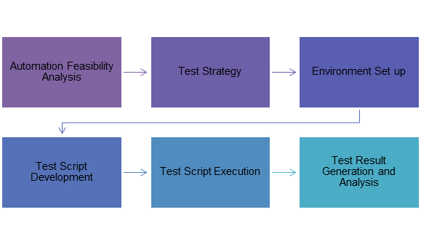
Automation Life Cycle

Slide 6
What is BDD?
In software engineering, behavior-driven development (BDD) is a software development process that emerged from test-driven development (TDD).
BDD is a development process where tests for code are written before the writing of implementation code.
BDD means examples (or scenarios) are written *before* the implementation of the software and happens iteratively, in collaboration with non-technical stakeholders.

Slide 7
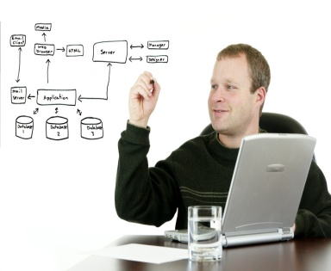
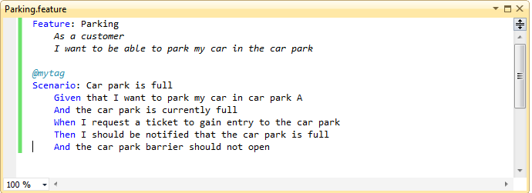

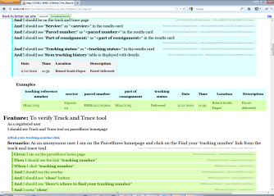
BDD development process
2.The Business Analyst, Tester, Developers elaborates requirements together.
3.The scenarios act as a guide to developer and act as automated tests
they define requirements as structued, english language format "scenarios"
Given - When - Then
1. The business Owner and Business Analyst have a discussion about what it he needs.
5.Automated test provide feedback on progress and help as documentation.
4. Tester uses these scenarios as basis of her tests.

Slide 8
“5 Whys” technique why use BDD
Q1. Why would we use BDD?
A1. To get a better quality product
Q2. Why?
A2. Because we (often) get it wrong
Q3. Why?
A3. Because there are misunderstandings, ambiguities or errors in what has been specified and/or what we eventually get in the form of the product
Q4. Why?
A4. Because the traditional methods for specifying behaviour are not always effective in capturing
Q5. Why?
A5. Because they fail to use concrete examples and a ubiquitous language

Slide 9
What Gherkin for ?
When we build software for stakeholders or client, it is difficult to figure out exactly what they want us to build.
We’ve all worked on projects where, because of a misunderstanding, code that we’d worked hard on for several days or more had to be thrown away.
Better communication between developers and stakeholders is essential to help avoid this kind of wasted time.

Slide 10
Building one Vocabulary :
eliminating some of ambiguity and miscommunication
for Business
for analyst
for Testers
for Developers

Slide 11
A Gherkin source file looks like
Feature: {custom title}
In order to {benefit/value of the feature}
As a {user/role who will benefit from this feature}
I need to {short feature description}
Scenario: Some determinable business situation
Given some precondition
And some other precondition
When some action by the actor
And some other action And yet another action
Then some testable outcome is achieved
And something else we can check happens too

Slide 12
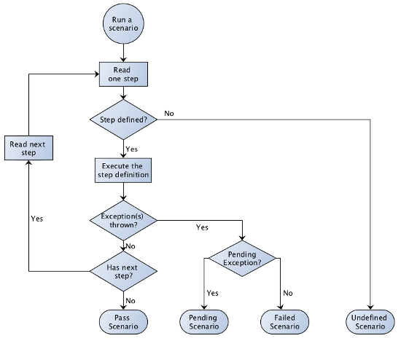
How Cucumber executes scenario

Slide 13
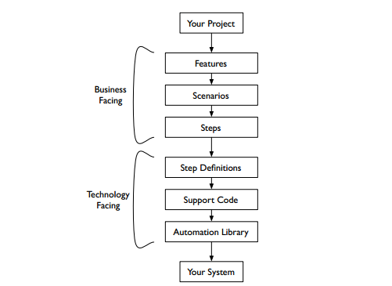
Cucumber testing stack

Slide 14
How cucumber works
Cucumber is a command-line tool.
When you run it, it reads in your specifications from plain-language text files called features, examines them for scenarios to test, and runs the scenarios against your system.
Each scenario is a list of steps for Cucumber to work through.
So that Cucumber can understand these feature files, they must follow some basic syntax rules.
The name for this set of rules is Gherkin.
Along with the features, you give Cucumber a set of step definitions, which map the business-readable language of each step into Ruby code to carry out whatever action is being described by the step.

Slide 15
How cucumber works
If the Ruby code in the step definition executes without error, Cucumber proceeds to the next step in the scenario.
If it gets to the end of the scenario without any of the steps raising an error, it marks the scenario as having passed.
If any of the steps in the scenario fail, however, Cucumber marks the scenario as having failed and moves on to the next one.
As the scenarios run, Cucumber prints out the results showing you exactly what is working and what isn’t.

Slide 16
How cucumber works
you can write your specifications in more than forty different spoken languages.
you can use tags to organize and group your scenarios, and you can easily integrate with a host of high-quality Ruby automation libraries to drive almost any kind of application.

Slide 17





1
JIRA Ticket is created and tester develops behat test.
Behat test is written.
Behat test verified against SIT and UAT environments.
Completed test is committed to new Git feature branch.
Pull request (review ticket )is created in Git tool for review.
After review completion JIRA ticket is updated.
and behat test is merged in Git central repository.
7. Jenkins build checks out latest behat tests from Git repo.
Currently daily 3 builds execute smoke tests in test environment.
9. Build produces behat test in HTML format.
10. Also HTML report/s mailed to everyone in team with Failure screens, (if any) daily from Jenkins.
Continuous Integration Server Jenkins
RML Smoke build
2
8
Shell
Script
3
9
6
5
Git feature
branch
Git central repository
7
4
10

Slide 18
Tools used
Jenkins - Continuous Build System
Git- CVS
Selenium standalone server in Linux machine as start up service in Hub mode
Behat- Test Framework
Firefox
Slack –notification
Key benefits of Smoke tests CI way
communication enhancement and customer satisfaction
Early feedback from SIT and UAT builds to developers i.e. after every new built of website, instant feedback can be provide
via smoke tests report.
Immediate bug detection
No integration step in the lifecycle

Slide 19
Summary
Discuss the topics covered
Reiterate your welcome
Remind the participants to submit paperwork
Wrap up the orientation session

